Slide 1



UNIT 6: Around the world
What’s the weather
like?

Slide 2
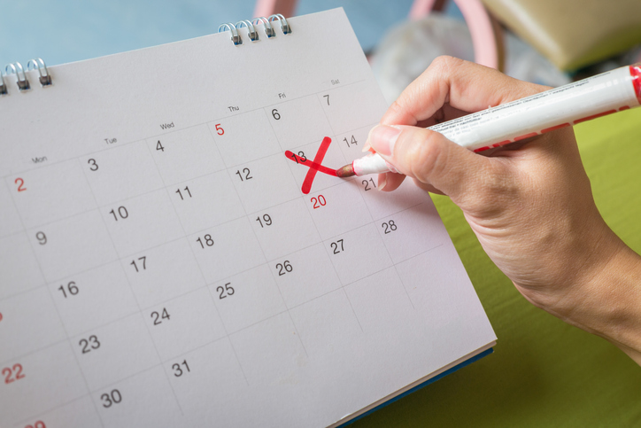
What date is today?
What day is it?
What month is it?
What year is it?
Can you name all the months?

Slide 3
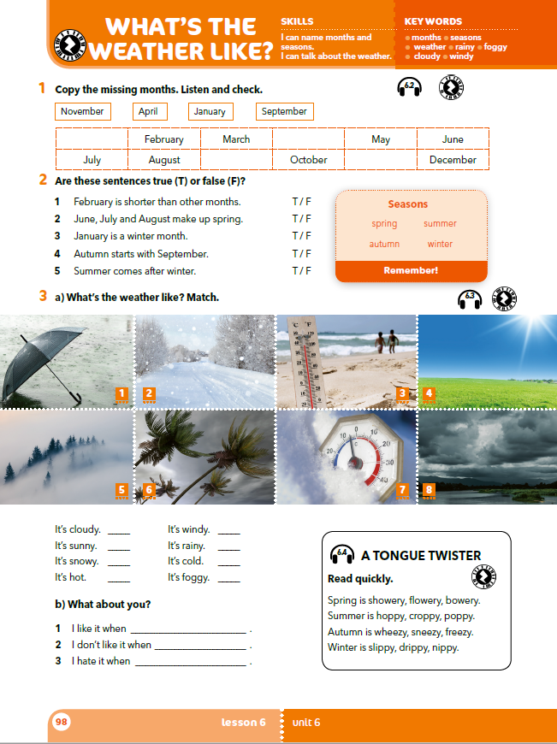
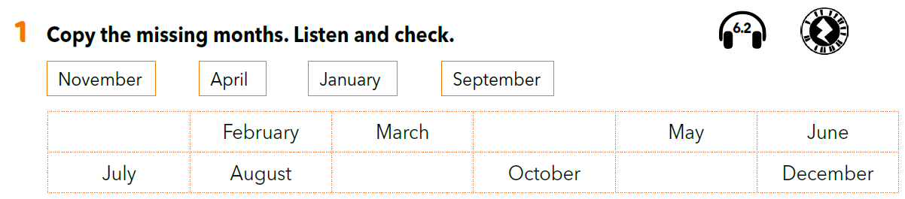

January
April
September
November
Listen and check your answers.
https://www.e-sfera.hr/dodatni-digitalni-sadrzaji/1b1639cc-2b2b-4dca-961c-a219b0d876ab/assets/audio/45_months.mp3
When is your birthday? In which month?

Slide 4
Can you name the seasons?
Copy the seasons and the months in your notebook.
spring
proljeće
summer
ljeto
autumn
jesen
winter
zima
March
April
May
June
July
August
September
October
November
December
January
February
Who was born in spring / summer / autumn / winter?
Which months does each season include?

Slide 5
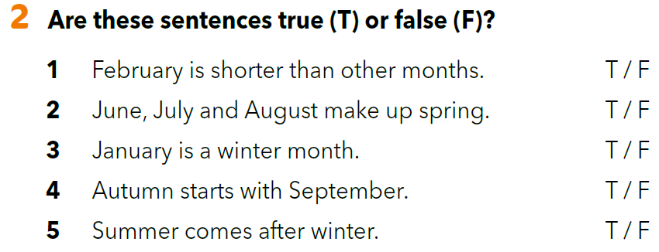

Slide 6
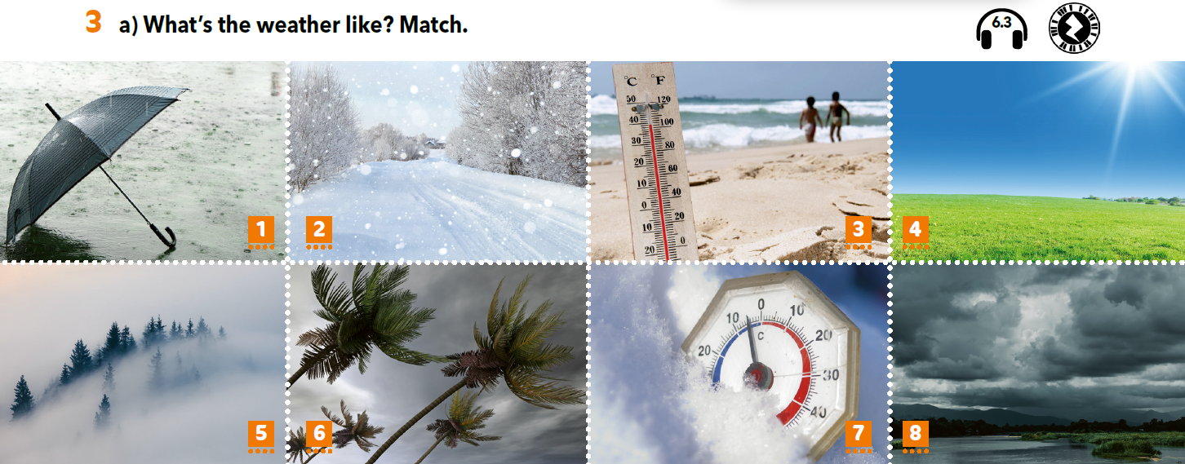
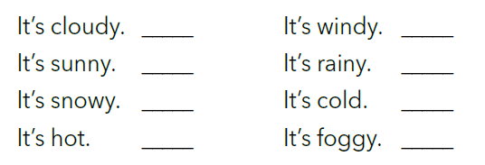
8
6
Match the pictures with the sentences.
4
1
Listen and check.
2
7
3
5

Slide 7
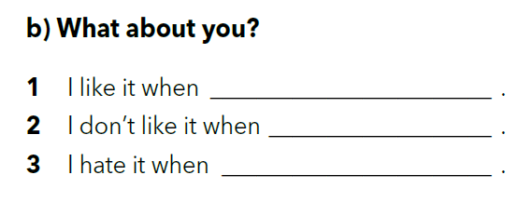
What’s the weather like today?
What kind of weather do you like?

Slide 8
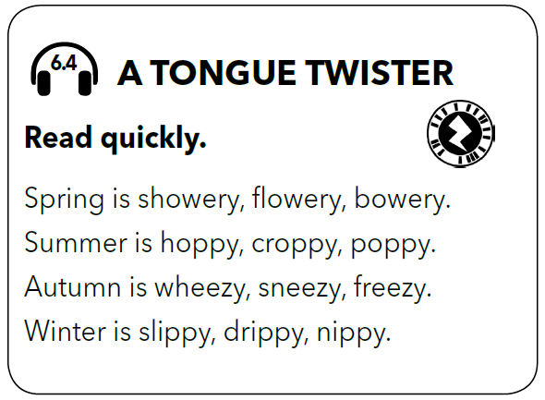
LET’S REVISE!
Click on the following link and solve the crossword.
https://wordwall.net/resource/260260/months-seasons
Listen to these tongue twisters.
Listen and repeat.
Try and say them as fast as you can.

Slide 9
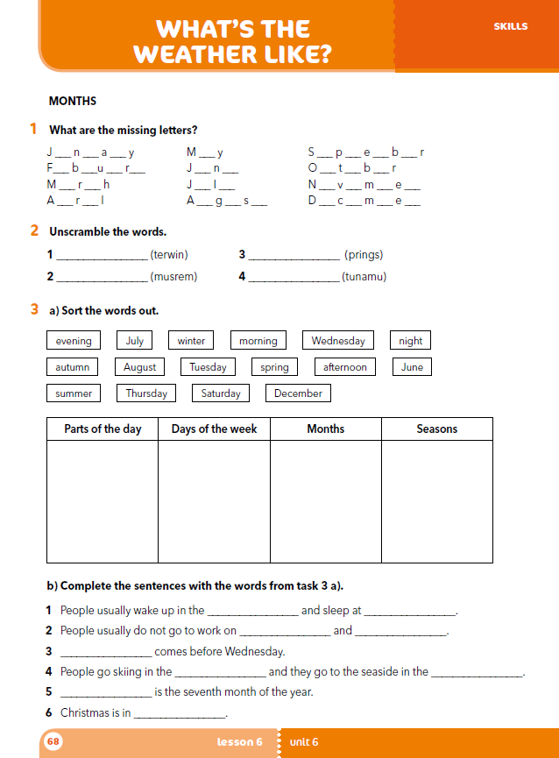
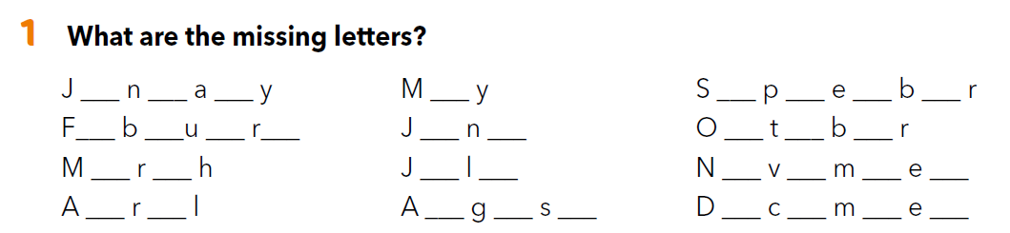
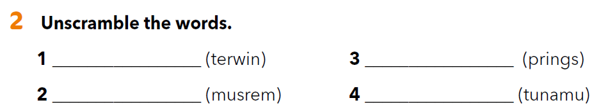
a u r
a
e t m e
e r a y
u e
c o e
a c
u y
o e b r
p i
u u t
e e b r
winter
spring
summer
autumn

Slide 10
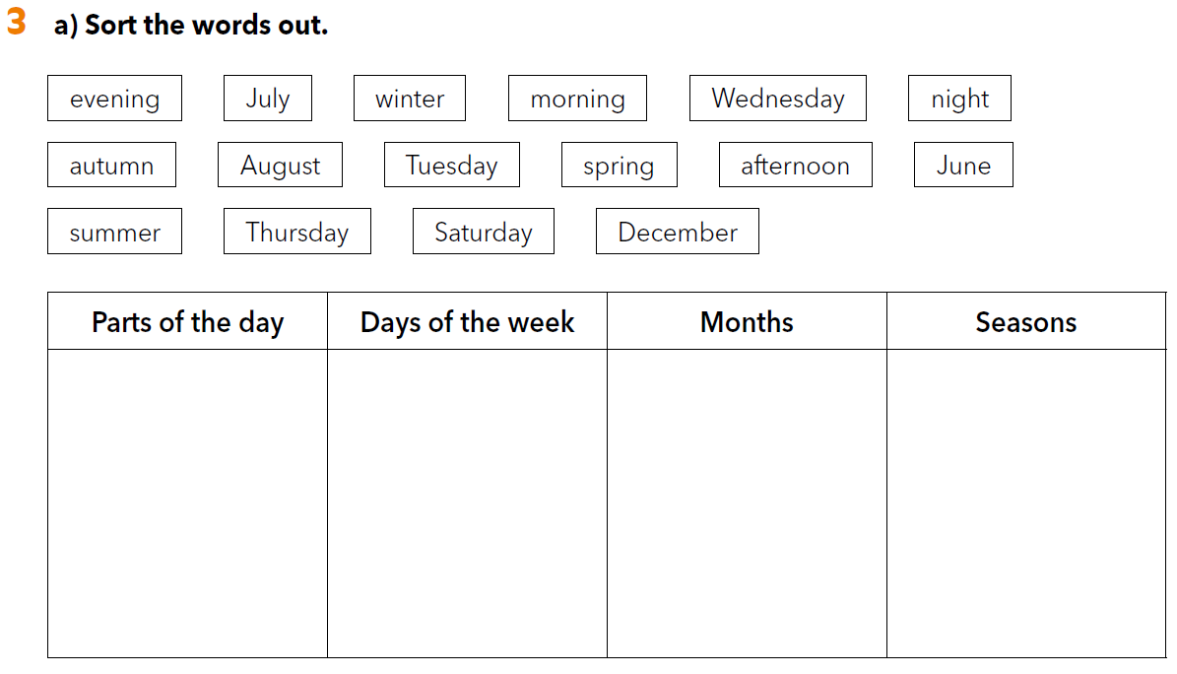
evening
morning
night
afternoon
Wednesday
Tuesday
Thursday
Saturday
July
August
June
December
winter
autumn
spring
summer

Slide 11
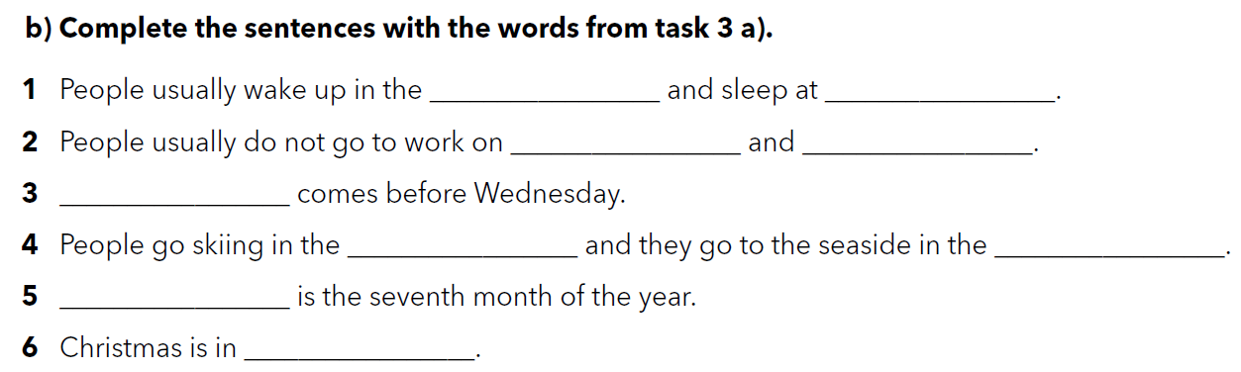
morning
night
Saturday
Sunday
Tuesday
winter
summer
July
December

Slide 12
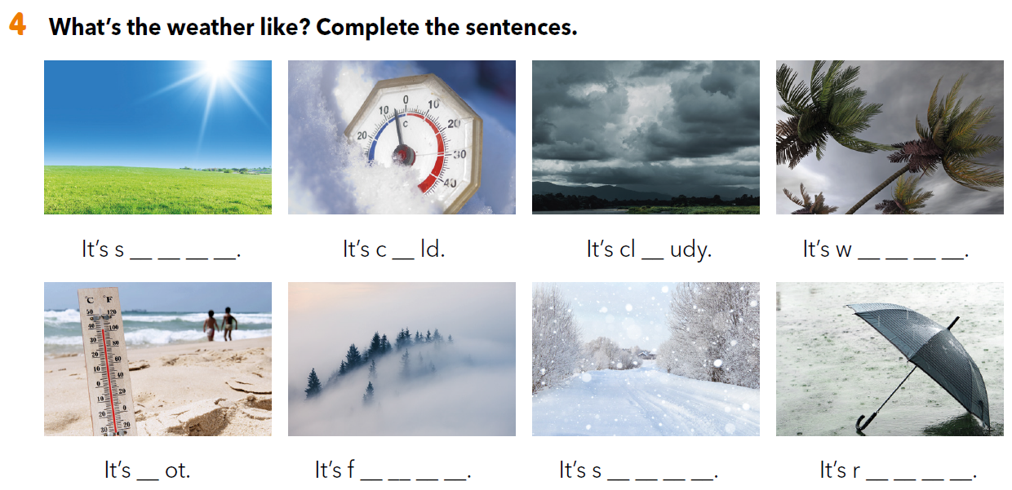
u n n y
o
o
i n d y
h
o g g y
n o w y
a i n y

Slide 13
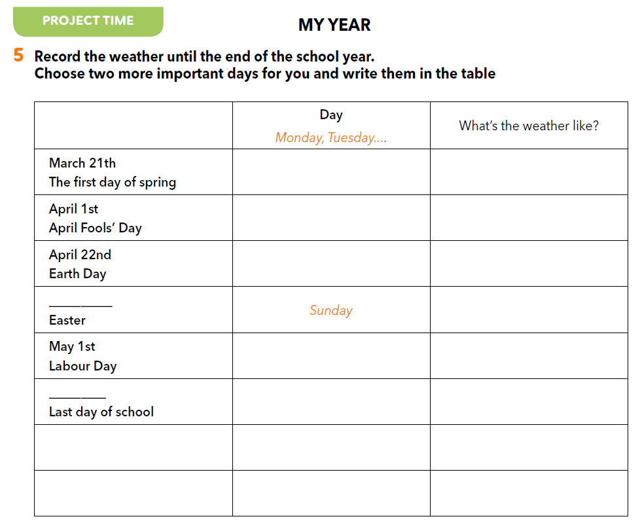
PROJECT TIME
Bilježi kakvo je vrijeme do kraja nastavne godine u tablicu. U njoj su već navedeni određeni datumi, a u zadnja dva reda možeš dopisati još dva datuma koja su tebi važna i zabilježiti kakvo je vrijeme tad bilo.

Slide 14

SELF CHECK
https://www.e-sfera.hr/dodatni-digitalni-sadrzaji/1b1639cc-2b2b-4dca-961c-a219b0d876ab/

Slide 15
Klikni na sljedeću poveznicu i odaberi LEARN MORE.
https://www.e-sfera.hr/dodatni-digitalni-sadrzaji/1b1639cc-2b2b-4dca-961c-a219b0d876ab/
The weather report
Pročitaj tekst i riješi pripadajuće zadatke.

